Slide 1
Latches & Flip Flop

Slide 2
Latch
Latch is a basic building element in sequential circuits. Latches do not have any clock signal , that is they are asynchronous sequential circuits.
• Latches are made up of static gates. • Latch is a bistable multivibrator i.e. it has two stable states and can switch between these states. • Latches will have a feedback path from the output. Thus they change their output at any instant using the previous and present states of the input signals. Example: S-R latch is an example for simple latch.

Slide 3
S-R Latch using NAND Gate
The gate outputs, labeled Q and Q respectively are latch outputs.
IN normal conditions, these outputs will always be the inverse of each other.
The SET input is the input that sets Q to the 1 state.
The RESET input is the input that resets Q to the 0 state.
S | R | Q | Q
1 | 1 | NC | NC
0 | 1 | 1 | 0
1 | 0 | 0 | 1
0 | 0 | 1*(Invalid) | 1*(Invalid)
*Produces Q=Q =1 which is Invalid

Slide 4
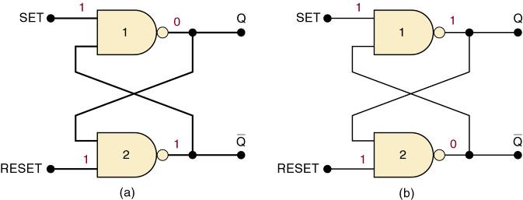
S-R Latch using NAND Gate
The NAND gate latch or simply latch is a basic FF.
Inputs are SET and CLEAR (RESET).
Inputs are active-LOW—output will change when the input is pulsed LOW.
When the latch is set: Q = 1 and Q = 0
When the latch is clear or reset: Q = 0 and Q = 1

Slide 5
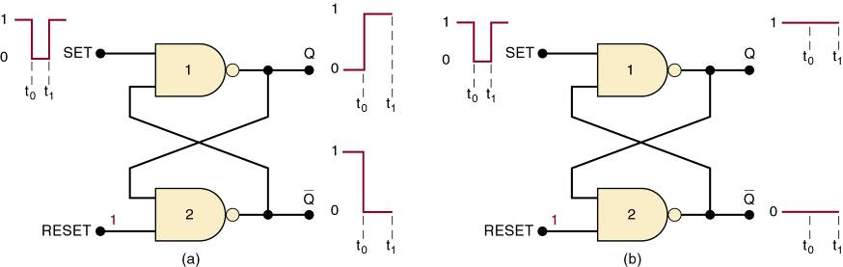
Setting the Latch
Pulsing the SET input to the 0 state...
(a) Q = 0 prior to SET pulse.
(b) Q = 1 prior to SET pulse.
In both cases, Q ends up HIGH.

Slide 6
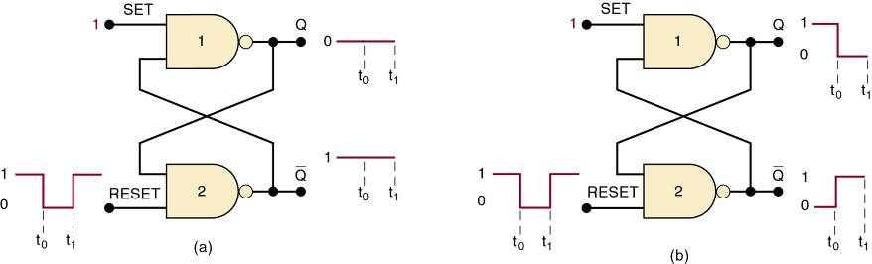
Resetting the Latch (FF)
Pulsing RESET LOW when...
(a) Q = 0 prior to the RESET pulse.
(b) Q = 1 prior to the RESET pulse.
In each case, Q ends up LOW.

Slide 7
S-R Latch - Summary
Summary of the S-R latch:
SET = 1, RESET = 1—Normal resting state, outputs remain in state they were in prior to input.
SET = 0, RESET = 1—Output will go to Q = 1 and remains there, even after SET returns HIGH. Called setting the latch.
SET = 1, RESET = 0—Will produce Q = 0 LOW and remains there, even after RESET returns HIGH. Called clearing or resetting the latch.
SET = 0, RESET = 0—Tries to set and clear the latch at the same time, and produces
Output is unpredictable, and this input condition should not be used.
Q = Q = 1.

Slide 8
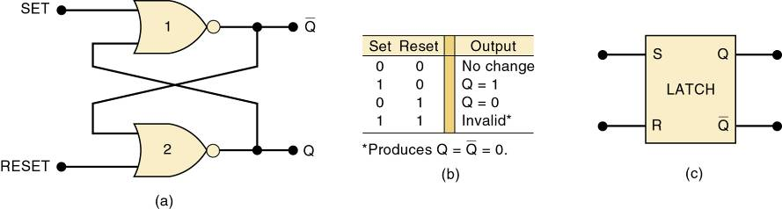
5-2 S-R latch using NOR Gate
Two cross-coupled NOR gates can be used as a NOR gate latch—similar to the NAND latch.
The Q and Q outputs are reversed.
The SET and RESET inputs are active-HIGH. Output will change when the input is pulsed HIGH.

Slide 9
Flip-Flop
The Flip-flop is also a building block of synchronous sequential circuits. It has two stable states. It can store one bit of information.
These devices have two states and a feedback path .
Flip flops will have a clock signal. Their state changes depending on the clock pulse .
Flip-Flop is edge sensitive. They will change their state when the clock signal transition occurs from low to high or high to low.
After the transition of clock signal from either 0 to 1 or 1 to 0 i.e. when the clock is at constant 0 or 1, the state remains unchanged even if the input changes.
Example: S-R flip flop, J-K Flip-Flop.

Slide 10
S R flip flops
J k flip flops
D flip flop
T flip flop

Slide 11
Application of flip flop
Do you know!! computers and calculators use Flip-flop for their memory.
Counters
Registers
Frequency Divider circuits
Data transfer

Slide 12
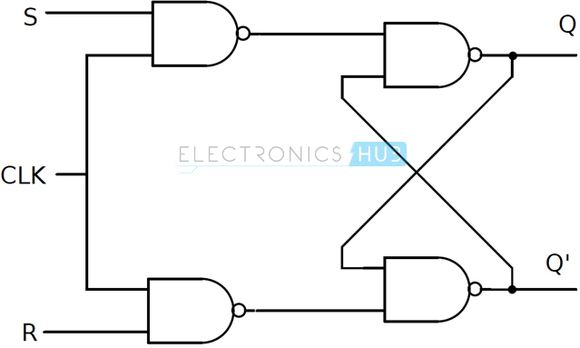
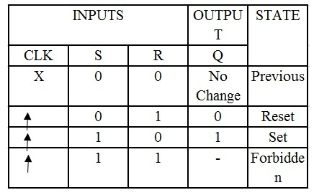
Clocked S-R flip flop
This circuit is formed by adding two NAND gates to NAND based SR flip – flop.
The inputs are active high as the extra NAND gate inverts the inputs.
A clock pulse is given as input to both the extra NAND gates. Hence the transition of the clock pulse is a key factor in functioning if this device.
Assuming it is a positive edge triggered device, the truth table and The circuit of clocked SR flip – flop using NAND gate is shown below:

Slide 13
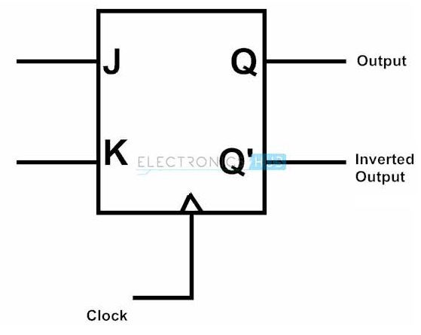
J-K flip flop
JK flip – flop is named after Jack Kilby, the electrical engineer who invented IC. A JK flip – flop is called a Universal Programmable flip – flop because, using its inputs J, K Preset and Clear, function of any other flip – flop can be imitated.
A JK flip – flop is the modification of SR flip – flop with no illegal state. In this the J input is similar to the SET input of SR flip – flop and the K input is similar to the RESET input of SR flip – flop. The block diagram of JK flip – flop is shown below.

Slide 14
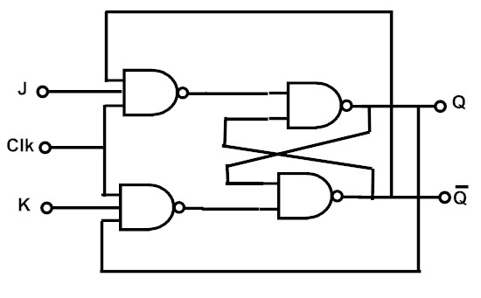
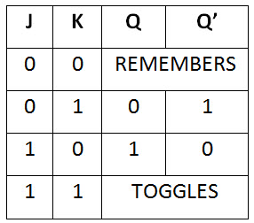
JK flip flop Logic Diagram
JK flip – flop logic diagram is shown in the below figure. As said before, JK flip – flop is a modified version of SR flip – flop. Logic diagram consists of three input NAND gates replacing the two input NAND gates in SR flip – flop and the inputs are replaced with J and K from S and R.
The design of the JK flip – flop is such that the three inputs to one NAND gate are J, clock signal along with a feedback signal from Q’ and the three inputs to the other NAND are K, clock signal along with a feedback signal from Q. This arrangement eliminates the indeterminate state in SR flip – flop.

Slide 15
Operation
Case 1 : When both the inputs J and K are LOW, then Q returns its previous state value i.e. it holds the previous data.
When we apply a clock pulse to the J K flip flop and the J input is low then irrespective of the other NAND gates, the NAND gate-1 output becomes HIGH. In the same manner, if the K input is low then output of NAND gate-2 is also HIGH. So thus the output remains in the same state i.e. no change in the state of flip flop.
Case 2 : When J is LOW and K is HIGH, then flip flop will be in Reset state i.e. Q = 0, Q’ = 1.
When we apply a clock pulse to the J K flip flop and the inputs are J is low and K is high the output of the NAND gate connected to J input becomes 1. Then Q becomes 0. This will reset the flip flop again to its previous state. So the Flip flop will be in RESET state.

Slide 16
Case 3 : When J is HIGH and K is LOW, then flip – flop will be in Set state i.e. Q = 1, Q’ = 0
When we apply a clock pulse to the J K flip flop and the inputs are J is high and K is low the output of the NAND gate connected to K input becomes 1. Then Q’ becomes 0. This will set the flip flop with the high clock input. So the Flip flop will be in SET state.
Case 4 : When both the inputs J and K are HIGH, then flip – flop is in Toggle state. This means that the output will complement of the previous state.

Slide 17
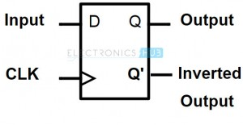
D flip flop
D flip – flops are also called as “Delay flip – flop” or “Data flip – flop”. They are used to store 1 – bit binary data. They are one of the widely used flip – flops in digital electronics. Apart from being the basic memory element in digital systems, D flip – flops are also considered as Delay line elements and Zero – Order Hold elements.
D flip – flop has two inputs , a clock (CLK) input and a data (D) input and two outputs; one is main output represented by Q and the other is complement of Q represented by Q’. The symbol of a D flip – flop is shown below.

Slide 18
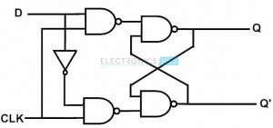
Construction
A D flip – flop is constructed by modifying an SR flip – flop. The S input is given with D input and the R input is given with inverted D input.
Hence a D flip – flop is similar to SR flip – flop in which the two inputs are complement to each other, so there will be no chance of any intermediate state occurs.
The major drawback of SR flip – flop is the race around condition which in D flip – flop is eliminated (because of the inverted inputs). The circuit diagram of D flip – flop is shown in below figure.

Slide 19
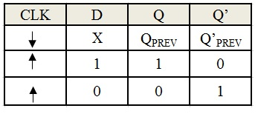
Operation
When we don’t apply any clock input to the D flip flop or during the falling edge of the clock signal, there will be no change in the output. It will retain its previous value at the output Q.
If the clock signal is high and if D input is high, then the output is also high and if D input is low, then the output will become low. Hence the output Q follows the input D in the presence of clock signal.

Slide 20
T flip flop

Slide 21
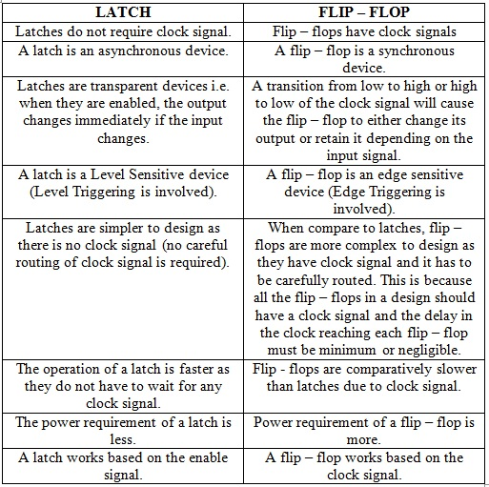
Latches Vs Flip flops

Slide 22
Conversion between Flip flops
J-K to others(S-R,D,T)
S-R to others(J_K,D,T)………

Slide 23
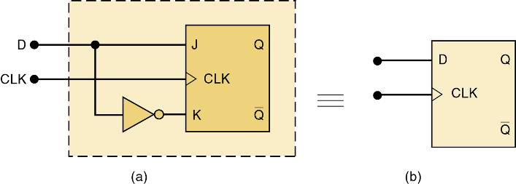
Conversion of JK flip to Clocked D Flip-Flop
A JK can be converted to an edge-triggered D flip-flop by adding a single INVERTER to the edge-triggered J-K flip-flop.
The same can be done to convert a S-R flip-flop to a D flip-flop.

